Slide 1
Ethanol Inputs
Unit 2, Lesson 1

Slide 2
Ethanol is a product of fermentation
Definition of fermentation: A chemical decomposition which takes place in an organic substance exposed to the air, due to the action of microscopic organisms.
Ethanol production product categories
Feedstock: Raw materials that are readily converted to fermented sugars.
Sugar- sugar beets, sugar cane, sweet sorghum, ripe fruits.
Starch- grains, potatoes, Jerusalem artichokes
Wastes: Forest material, garbage, sewage, crop residue
Cellulose- stover, grasses, wood

Slide 3
Feedstocks
Sweet sorghum
Jerusalem artichoke
Sugar cane
Fodder beets
Sugar beets
Fruit crop
Starch crop
Crop residue
Forage crop

Slide 4
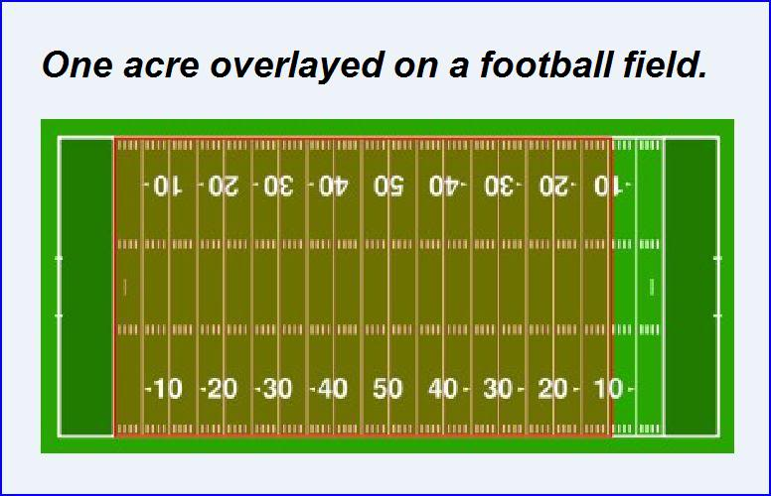
Factors in ethanol production
In choosing which crops that are made into ethanol, individuals must look at both yield and economics.
1 acre sugar beets = 727 gallons ethanol
1 acre of sugarcane = 584 gallons ethanol
1 acre of sorghum = 374 gallons ethanol
1 acre of corn = 354 gallons ethanol
1 acre wheat = 110 gallons ethanol

Slide 5
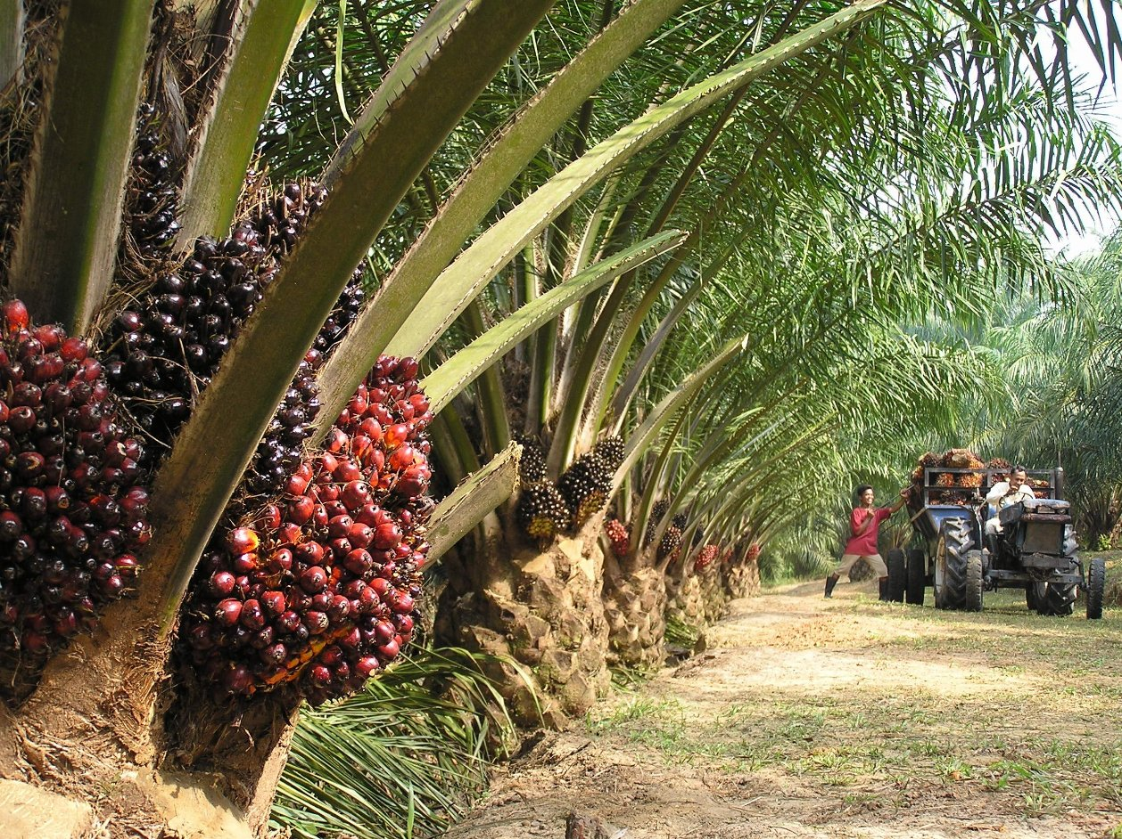
Comparing to biodiesel production
In choosing which crops that are made into biodiesel, individuals must look at both yield and economics.
1 acre oil palm = 508 gallons biodiesel
1 acre coconut = 230 gallons biodiesel
1 acre rapeseed = 102 gallons biodiesel
1 acre peanuts = 90 gallons biodiesel
1 acre sunflower = 82 gallons biodiesel
1 acre soybeans = 65 gallons biodiesel

Slide 6
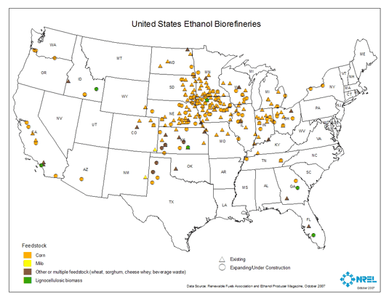
Factors in ethanol production
In choosing which crops that are made into ethanol, individuals must look at both yield and economics.
Production requires a steady source (i.e. food waste could be inconsistent)
Distance feedstock travels to ethanol plant determines feasibility (usually not more than 30-40 miles is considered economically viable)
Distance from ethanol plant to end user (60 to 100 miles is considered economically feasible)

Slide 7
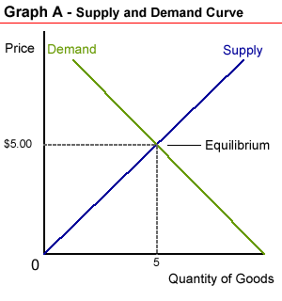
Factors in ethanol production
Economy-supply and demand curve. The price of gasoline is a determining factor of whether or not to turn crops to gas.
Example of sugar beets: Prices are low, demand is low, and sugar refineries are closing their doors; resulting in a higher alcohol per acre yield.

